Slide 1




WORK METHODOLOGIES FOR EDUCATORS

Slide 2
Contents
Objectives
the augMENTOR solution
The tesa FRAMEWORK
CREATIVE PEDAGOGY AND THE 4Cs
4cs assessment
CREATE AN AUGMENTOR COURSE the augmentor platform

Slide 3
Objectives
These slides will support you to:
Understand the augMENTOR solution components
Adapt an existing lesson to the TESA phases
Learn about the 4Cs and how to assess them
Structure your course more efficiently

Slide 4
Contents
Objectives
the augMENTOR solution
The tesa FRAMEWORK
CREATIVE PEDAGOGY AND THE 4Cs
4cs assessment
CREATE AN AUGMENTOR COURSE the augmentor platform

Slide 5
The augMENTOR Solution
augMENTOR weaves modern tech into teaching/learning via:
a state-of-the-art pedagogical framework
an AI-boosted platform that supports
    - educators to design and deliver advanced courses
    - learners to maximize their performance.

Slide 6

The augMENTOR Solution
Pedagogical Framework consists of two parts:
Pedagogical Design Model with Emerging Technologies (PeDeMET) – the macro-level with focus on “what and why”
Technology-augmented Educational Scenarios and e-Activities (TESA) - micro-level with focus on “how”
Particular emphasis is set on the development/assessment of transversal skills through an approach that employs AI as a partner, not a replacement.
The TESA framework defines how to teach with AI responsibly while the platform makes it operational.

Slide 7

The augMENTOR Solution
The The AI-Driven platform deploys the pedagogical framework through a dedicated Learner Model
Evidence-based only! - augMENTOR will produce feedback based on the input from the connected course. If data is missing; queries may return little or no feedback.
The platform offers educators progress-aware feedback, tailored recommendations and course design guidelines
augMENTOR is not generic AI advice; it is course-specific. The better your design and signals, the sharper the insights and recommendations.
The TESA framework defines how to teach with AI responsibly while the platform makes it operational.

Slide 8
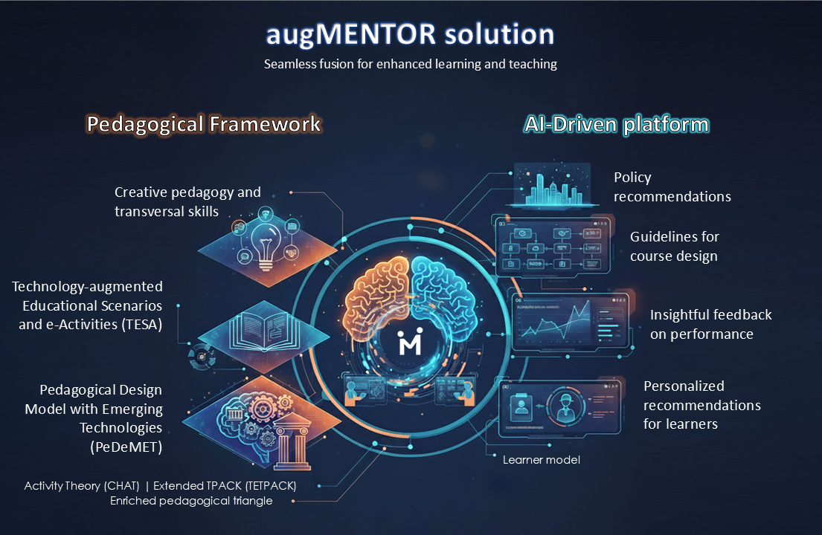
An overview of The augMENTOR Solution

Slide 9
Contents
Objectives
the augMENTOR solution
The tesa FRAMEWORK
CREATIVE PEDAGOGY AND THE 4Cs
4cs assessment
CREATE AN AUGMENTOR COURSE the augmentor platform

Slide 10
The tesa framework
TESA – Technology-augmented Educational Scenarios and e-Activities
TESA details the design of educational scenarios and pedagogical e-Activities.
It is the product and process of applying the PeDeMET model in real-world settings.
Educational scenarios designed using TESA differ from conventional 'lesson plans', emphasizing and including diverse constructivist and collaborative strategies for teaching and learning, considering cognitive difficulties and alternative representations with learners at their epicenter.
augMENTOR educational scenarios are based on TESA so to meaningfully integrate emerging technologies to teach and learn key concepts of a subject within the existing curriculum, while also fostering high-level competencies, such as 21st-century skills.

Slide 11
The tesa framework
TESA – Technology-augmented Educational Scenarios and e-Activities
An educational scenario includes:
              teacher instructions
              the theoretical framework supporting the approach
              essential materials for implementation
              'activity sheets' for learners, and
              additional resources considered valuable (e.g. printed materials, software files etc).
TESA follows seven phases, describing the rationale on which a scenario should be based (Phases A, B & C) and the way in which classroom activities are designed (Phases D & E) and how the scenario is implemented and evaluated (Phases F & G).
In its final form, an eighth phase can be added to document the scenario after at least one full cycle of planning, implementation and evaluation.

Slide 12

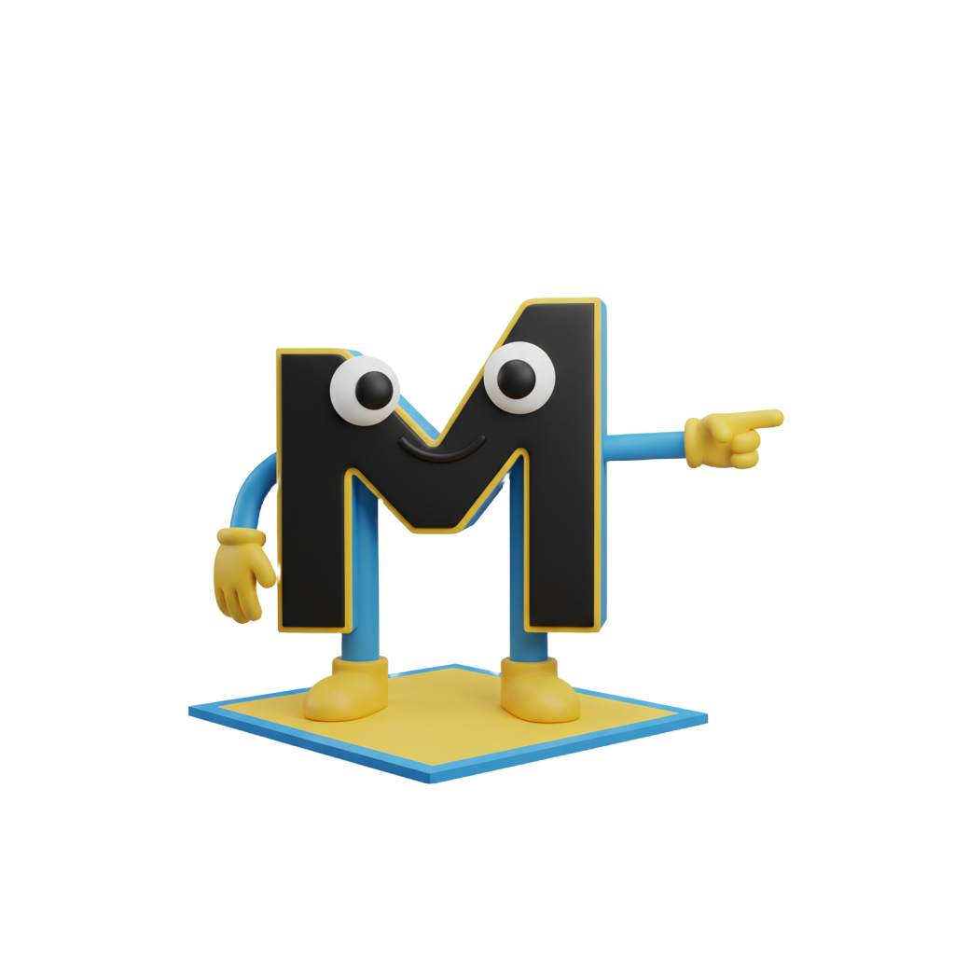
The 8 phases of tesa
Universal Design Learning (UDL) can be a great too to assist you!
UDL is a way of planning teaching so that all learners can access and succeed, by offering multiple ways to engage with content, understand information, and show what they have learned
https://udlguidelines.cast.org/
A
Teaching analysis of the subject matter
B
Cognitive analysis
C
Purpose and objectives
D
Development - selection of materials and Tools
E
Development of learning activities
F
Application in the classroom (implementation and evaluation)
G
Assessment/review (student and scenario) and possible extensions of the scenario
Assessment & Feedback
H
Documentation
Scenario Subject, Theme, & Audience (Content Knowledge)
Learning Outcomes & Goals (Outcome/ Object)
Learners' representations of the subject matter and possible difficulties in their thinking
ICT Tools, Emerging Technologies and materials development
In-Class e-Activities (In-situ & Online) (Learning Strategies)
Implementation Plan (Rules/ Division of Labor)
Scenario Documentation & Reflection (Institutional Context)
Follow the TESA phases to design your course

Slide 13
The 8 phases of tesa
A
Teaching analysis of the subject matter
B
Cognitive analysis
C
Purpose and objectives
D
Development - selection of materials and Tools
E
Development of learning activities
F
Application in the classroom (implementation and evaluation)
G
Assessment/review (student and scenario) and possible extensions of the scenario Assessment & Feedback
H
Documentation
Scenario Subject, Theme, & Audience (Content Knowledge)
Learning Outcomes & Goals (Outcome/ Object)
Learners' representations of the subject matter and possible difficulties in their thinking
ICT Tools,Emerging Technologies and materials development
In-Class e-Activities (In-situ & Online) (Learning Strategies)
Implementation Plan (Rules/ Division of Labor)
Scenario Documentation & Reflection (Institutional Context)

Slide 14
Phase a: Teaching analysis of the subject matter
“The What”
Scenario subject, Theme & audience
Purpose of this phase
Clarify what you are teaching and the audience of your lesson
Key design questions
What subject area and topic will your lesson address?
Who is your target audience (age, level, classroom context)?
What prerequisite knowledge or experiences should your learners already have?
Concrete actions
Define the core subject and topics
Align with curriculum objectives
Justify suitability for the target learners
Establish the foundational content knowledge
UDL Tip:
When defining your target group, list major barriers to access (language,
devices, reading level, sensory needs) so you can plan options from the start.

Slide 15
The 8 phases of tesa
A
Teaching analysis of the subject matter
B
Cognitive analysis
C
Purpose and objectives
D
Development - selection of materials and Tools
E
Development of learning activities
F
Application in the classroom (implementation and evaluation)
G
Assessment/review (student and scenario) and possible extensions of the scenario Assessment & Feedback
H
Documentation
Scenario Subject, Theme, & Audience (Content Knowledge)
Learning Outcomes & Goals (Outcome/ Object)
Learners' representations of the subject matter and possible difficulties in their thinking
ICT Tools,Emerging Technologies and materials development
In-Class e-Activities (In-situ & Online) (Learning Strategies)
Implementation Plan (Rules/ Division of Labor)
Scenario Documentation & Reflection (Institutional Context)

Slide 16
Phase b: Cognitive Analysis
“The barriers”
Learners’ prior knowledge & misconceptions
Purpose of this phase
Identify the thinking demands and problem-solving steps learners must perform
Ensure tasks are aligned with learners’ developmental level, prior knowledge, and potential misconceptions
Key design questions
What prior knowledge must learners bring, and what gaps or misconceptions might appear?
What support will learners need during complex tasks?
Concrete actions
Break the learning content into cognitive steps (e.g., “interpret data → compare → draw conclusions”)
Research and anticipate common misconceptions and learning difficulties
Lay the foundation for overcoming roadblocks
UDL Tip:
For demanding cognitive steps, plan supports in advance (checklists, worked examples, graphic organisers) – don’t wait until students struggle.

Slide 17
The 8 phases of tesa
A
Teaching analysis of the subject matter
B
Cognitive analysis
C
Purpose and objectives
D
Development - selection of materials and Tools
E
Development of learning activities
F
Application in the classroom (implementation and evaluation)
G
Assessment/review (student and scenario) and possible extensions of the scenario Assessment & Feedback
H
Documentation
Scenario Subject, Theme, & Audience (Content Knowledge)
Learning Outcomes & Goals (Outcome/ Object)
Learners' representations of the subject matter and possible difficulties in their thinking
ICT Tools,Emerging Technologies and materials development
In-Class e-Activities (In-situ & Online) (Learning Strategies)
Implementation Plan (Rules/ Division of Labor)
Scenario Documentation & Reflection (Institutional Context)

Slide 18
Phase c: Purpose and objectives
Learning outcomes & 4cs goals
Purpose of this phase
Make explicit the overall purpose of your lesson/scenario
Formulate clear, measurable objectives connecting content, 4Cs and the use of the augMENTOR solution
Ensure everyone (educators, learners, observers) shares the same picture of success
Key design questions
What is the main educational purpose of this lesson/scenario?
Which objectives must learners reach by the end?
How will these objectives be observable in learners’ behaviour, products or interactions?
Concrete actions
Write a short purpose statement describing why this lesson/scenario is worth completing.
Define 2-3 objectives using action verbs (e.g. make use of Bloom Taxonomy)
Define 1-2 transversal objectives linked to the fostering of the 4Cs
UDL Tip:
Keep objectives fixed, but allow different ways to meet them (oral, written, visual, digital). Note at least two formats students could use.

Slide 19
The 8 phases of tesa
A
Teaching analysis of the subject matter
B
Cognitive analysis
C
Purpose and objectives
D
Development - selection of materials and Tools
E
Development of learning activities
F
Application in the classroom (implementation and evaluation)
G
Assessment/review (student and scenario) and possible extensions of the scenario Assessment & Feedback
H
Documentation
Scenario Subject, Theme, & Audience (Content Knowledge)
Learning Outcomes & Goals (Outcome/ Object)
Learners' representations of the subject matter and possible difficulties in their thinking
ICT Tools,Emerging Technologies and materials development
In-Class e-Activities (In-situ & Online) (Learning Strategies)
Implementation Plan (Rules/ Division of Labor)
Scenario Documentation & Reflection (Institutional Context)

Slide 20
Phase d: Design & development of tools
Emerging technologies & materials
Purpose of this phase
Select the digital tools needed to implement the lesson/scenario
Ensure these tools support the learning objectives from Phase C and the cognitive demands from Phase B
Key design questions
What technological tools best support the lesson?
Do the tools provide opportunities to practice the 4Cs?
How will the tools support differentiation, accessibility, and varied learning needs?
Which tools must be prepared in advance, and which will be generated by learners during the activity?
Concrete actions
Identify the specific AI/LMS tools (e.g. Moodle Quiz, Assignments, SCORM) and materials
Justify how they add value over traditional methods
Test each tool to ensure it works smoothly in your context
UDL Tip:
For every key concept, aim for at least two representations (text + visual, demo + handout) and two ways students can respond (e.g. text OR audio).

Slide 21
The 8 phases of tesa
A
Teaching analysis of the subject matter
B
Cognitive analysis
C
Purpose and objectives
D
Development - selection of materials and Tools
E
Development of learning activities
F
Application in the classroom (implementation and evaluation)
G
Assessment/review (student and scenario) and possible extensions of the scenario Assessment & Feedback
H
Documentation
Scenario Subject, Theme, & Audience (Content Knowledge)
Learning Outcomes & Goals (Outcome/ Object)
Learners' representations of the subject matter and possible difficulties in their thinking
ICT Tools,Emerging Technologies and materials development
In-Class e-Activities (In-situ & Online) (Learning Strategies)
Implementation Plan (Rules/ Division of Labor)
Scenario Documentation & Reflection (Institutional Context)

Slide 22
Phase e: development of learning e-activities
“learning strategies”
In-class e-activities
Concrete actions
Draft a step-by-step scenario timeline with approximate timing for each e-Activity
For each step, specify:
  Instructors’ actions (instructions, demonstrations, facilitation points)
  Learner actions (discuss, create, post, respond, solve, present)
  Digital tool used and why it is pedagogically useful
Mark which activities correspond to:
  Psychological & cognitive preparation
  Subject teaching
  Consolidation
  Assessment opportunities
  Metacognitive reflection
Check that the final chain of e-Activities is realistic in time, flows smoothly, and stays aligned with the objectives from Phase C and the tools from Phase D.
Purpose of this phase
Transform the lesson’s/scenario’s goals into a concrete sequence of e-Activities
Describe what educators and learners do in the classroom, step-by-step
Key design questions
What is the chronological flow of the lesson? (intro, exploration, main task, wrap-up, reflection)
Which parts of the flow will be supported by the selected digital tools?
Where will students work individual?, and where will they collaborate with their peers?
How do the activities foster the 4Cs?
UDL Tip:
Add small choices into the sequence (topic, role, tool,
product format). Choice boosts engagement and supports diverse learners

Slide 23
Phase e: development of learning e-activities
“learning strategies”
In-class e-activities
Purpose of this phase
Transform the lesson’s/scenario’s goals into a concrete sequence of e-Activities
Describe what educators and learners do in the classroom, step-by-step
Key design questions
What is the chronological flow of the lesson? (intro, exploration, main task, wrap-up, reflection)
Which parts of the flow will be supported by the selected digital tools?
Where will students work individual?, and where will they collaborate with their peers?
How do the activities foster the 4Cs?

Slide 24
Phase e: development of learning e-activities
“learning strategies”
In-class e-activities
Concrete actions
Draft a step-by-step scenario timeline with approximate timing for each e-Activity
For each step, specify:
  Instructors’ actions (instructions, demonstrations, facilitation points)
  Learner actions (discuss, create, post, respond, solve, present)
  Digital tool used and why it is pedagogically useful
Mark which activities correspond to:
  Psychological & cognitive preparation
  Subject teaching
  Consolidation
  Assessment opportunities
  Metacognitive reflection
Check that the final chain of e-Activities is realistic in time, flows smoothly, and stays aligned with the objectives from Phase C and the tools from Phase D.
UDL Tip:
Add small choices into the sequence (topic, role, tool,
product format). Choice boosts engagement and supports diverse learners

Slide 25
The 8 phases of tesa
A
Teaching analysis of the subject matter
B
Cognitive analysis
C
Purpose and objectives
D
Development - selection of materials and Tools
E
Development of learning activities
F
Application in the classroom (implementation and evaluation)
G
Assessment/review (student and scenario) and possible extensions of the scenario Assessment & Feedback
H
Documentation
Scenario Subject, Theme, & Audience (Content Knowledge)
Learning Outcomes & Goals (Outcome/ Object)
Learners' representations of the subject matter and possible difficulties in their thinking
ICT Tools,Emerging Technologies and materials development
In-Class e-Activities (In-situ & Online) (Learning Strategies)
Implementation Plan (Rules/Division of Labor)
Scenario Documentation & Reflection (Institutional Context)

Slide 26
Phase f: application in the classroom
“roles & division of labour”
Implementation plan
Purpose of this phase
Implement in the classroom the scenarios designed in the previous phase
Ensure that your e-Activities are carried out in a way that produces meaningful data and learning evidence
Key design questions
How will you open the lesson to activate prior knowledge and surface difficulties?
How will learners practice and consolidate new knowledge?
How will you handle practical issues (e.g. time management, group organisation)?.
Concrete actions
Write a brief implementation script for the session, structured in 5 moments:
  Preparation: short diagnostic question/poll/discussion
  Subject: targeted explanation
  Consolidation: learners work on designed e-Activities
  Assessment: Quick formative check
  Metacognition: 2-3 reflection points and the mental-effort question at the end of the scenario.
Detail the organisation of roles (Learner/Educator) and the practical instructions for tutors and e-sheets for learners.
UDL Tip:
Offer alternative participation modes (speak, type in chat, post in forum) so all students can contribute in a way that works for them.

Slide 27
The 8 phases of tesa
A
Teaching analysis of the subject matter
B
Cognitive analysis
C
Purpose and objectives
D
Development - selection of materials and Tools
E
Development of learning activities
F
Application in the classroom (implementation and evaluation)
G
Assessment/review (student and scenario) and possible extensions of the scenario Assessment & Feedback
H
Documentation
Scenario Subject, Theme, & Audience (Content Knowledge)
Learning Outcomes & Goals (Outcome/ Object)
Learners' representations of the subject matter and possible difficulties in their thinking
ICT Tools,Emerging Technologies and materials development
In-Class e-Activities (In-situ & Online) (Learning Strategies)
Implementation Plan (Rules/ Division of Labor)
Scenario Documentation & Reflection (Institutional Context)

Slide 28
Phase g: assessment – review
“the data”
Evaluation & feedback
Purpose of this phase
Evaluate the impact of the educational scenario from two angles:
  Student learning (knowledge, 4Cs, engagement)
  Scenario effectiveness (design, tools, activities, timing)
Define how formative and summative assessment will be carried out
Specify which 4Cs rubric will be applied (critical for AI data collection)
Key design questions
How will you measure learning outcomes for content and 4Cs?
Which formative assessments will run during the scenario, and which summative ones at the end?
What 4Cs rubrics will you use, and for which activities?
How will you collect data on student performances?
Concrete actions
Define 1–2 summative assessment tasks aligned with your Phase C objectives
Attach 4Cs rubrics (with proper tagging, levels 0.25–1.0) to at least one key activity per module
After implementation, review:
  Learner performance data
  Engagement data
  Qualitative feedback
UDL Tip:
When possible, assess the same objective with more than one product type (e.g. report OR video) while using the same rubric criteria.

Slide 29
The 8 phases of tesa
A
Teaching analysis of the subject matter
B
Cognitive analysis
C
Purpose and objectives
D
Development - selection of materials and Tools
E
Development of learning activities
F
Application in the classroom (implementation and evaluation)
G
Assessment/review (student and scenario) and possible extensions of the scenario Assessment & Feedback
H
Documentation
Scenario Subject, Theme, & Audience (Content Knowledge)
Learning Outcomes & Goals (Outcome/ Object)
Learners' representations of the subject matter and possible difficulties in their thinking
ICT Tools,Emerging Technologies and materials development
In-Class e-Activities (In-situ & Online) (Learning Strategies)
Implementation Plan (Rules/ Division of Labor)
Scenario Documentation & Reflection (Institutional Context)

Slide 30
Phase h: documentation & reflection
“institutional context”
Scenario documentation
Purpose of this phase
Systematically document the scenario: context, design, implementation, and outcomes.
Engage in professional reflection on what worked, what didn’t, and why.
Make the scenario reusable and shareable
Key design questions
What should be documented so that someone else could understand and reuse this scenario?
What evidence can be found about:
  Content learning
  Development of the 4Cs
  Engagement, motivation, difficulties
What did this experience tell you about the strengths and weaknesses of this scenario?
How did the digital tools support learning?
What do the learners’ voices reveal?
Which specific changes should be made next time?
Concrete actions
Document the key learnings
Create guidelines for reuse
UDL Tip:
In your reflection, ask:
“Which students were left out by my design?” Then adjust materials, options, and tools, not just “student effort”.

Slide 31
Contents
Objectives
the augMENTOR solution
The tesa FRAMEWORK
CREATIVE PEDAGOGY AND THE 4Cs
4cs assessment
CREATE AN AUGMENTOR COURSE the augmentor platform

Slide 32
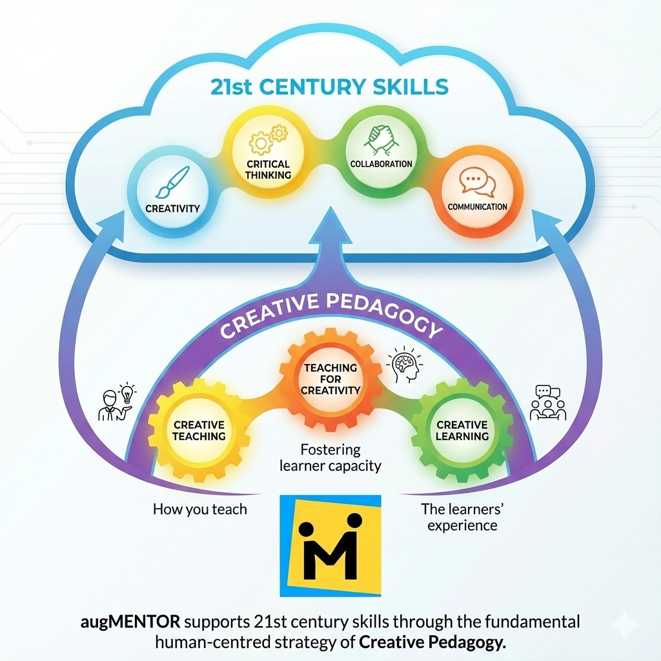
CREATIVE PEDAGOGY AND THE 4Cs
21st century competencies equip learners to navigate in a rapidly evolving world shaped by digitalization, complexity, and innovation.
Creativity, Critical thinking, Collaboration and Communication, - also known as the ‘4Cs’ - are the core competences focusing particularly on the Learning and Innovation part of the 21st century skills framework.
The 4Cs are core elements of the augMENTOR framework and are supported through the Creative pedagogy strategy.
Creative pedagogy is the fundamental human-centred strategy woven throughout the augMENTOR pedagogical framework; it combines creative teaching, teaching for creativity and creative learning.

Slide 33
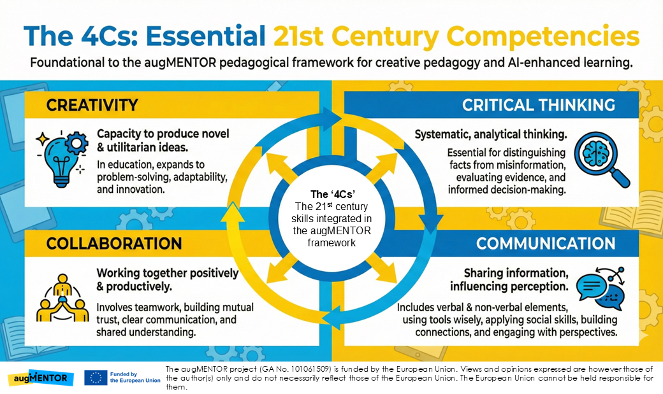

Slide 34
Each C in practice
Creativity
Critical Thinking
Collaboration
Communication
Producing original ideas/solutions that are also useful and feasible.
Analysing problems and information in a structured, evidence-based way.
Working together constructively towards a shared outcome.
Expressing ideas clearly and appropriately for different audiences and contexts.
Includes:
  Divergent thinking;
  Trying new approaches
  Adapting ideas to context
Includes:
  Identifying key components;
  Exploring perspectives;
  Forming justified opinions
Includes:
  Sharing understanding;
  Coordinating roles;
  Taking appropriate actions as a team
Includes:
  Adapting message;
  Choosing effective media;
  Interacting respectfully in diverse settings

Slide 35

integrating 4Cs development through your course
While developing learning e-activities (TESA phase E) ensure that they are constructed and delivered in a way so that they promote the development of the 4Cs.
Creative teaching (How you teach) – Design diverse content and deliver enabling responsiveness and flexibility
Teaching for creativity (Fostering learner capacity) – Deploy student-centred approaches that promote student growth
through initiative
Creative learning (The learners’ experience) –
Promote autonomy and inquiry

Slide 36
WAYS to integrate – CREATIVITY
Divergent vs Convergent
  Teach students the different goals and strategies of divergent and convergent thinking
Create safe spaces
  Learners need safe spaces before they will feel comfortable enough to offer truly innovative solutions
Career Role Playing
  Having learners take specific roles when addressing a problem can help promote divergent and convergent thinking
Reverse engineering
  Allow learners to find alternative uses for common, household items
Foster a Growth Mindset
  Teach learners that intelligence and creativity are malleable skills requiring practice, hard work, and iteration
Encourage Choice
  Learners will feel more empowered when they are given choices and the autonomy to see those choices through

Slide 37
WAYS to integrate – critical thinking
Ask open ended questions
  Encourage students to think deeply by posing questions that don’t have a single correct answer
Encourage debate
  Have students consider or argue for different perspectives on a topic to develop reasoning skills
Realistic problem-solving
  Set realistic expectations when asking students to address big, real-world problems by breaking larger problems into smaller ones
Implement reflection time
  Allow brief periods for students to consider what they’ve learned and its implications
Use analogies
  Ask students to draw connections between the lesson content and authentic, familiar concepts or situations
Teach evaluation of sources
  Guide students in assessing the credibility and bias of information related to the lesson

Slide 38
WAYS to integrate – collaboration
Incorporate Group Work
  Incorporate group work into your lessons to encourage collaboration and divergent thinking
Interdependence Strategy
  Structuring tasks so that team members need each other to succeed
Social Skills Development
  Teaching and practicing interpersonal and small group skills through a
  variety of group activities
Design Thinking Principles
  Teach students design thinking principles which focuses on empathy and collaboration through a variety of strategies
Use Case Studies
  Find engaging, authentic examples of collaboration to serve as models then give students the opportunity to dissect the case studies and pull-out strategies
Evaluate Group Work
  Allow groups to self-evaluate and reflect on their collaborative work by identifying strengths and opportunities

Slide 39
WAYS to integrate – communication
Use Active Listening
  Encourage students to concentrate, understand, respond, and take notes when others are talking
Empathetic Communication
  Express thoughts and feelings directly and respectfully, while considering others’ opinions and contexts
Share your work
  Give students plentiful opportunities to present their work or opinions to audiences and consider feedback
Nonverbal Communication
  Teach students how to recognize and use nonverbal strategies when communicating
Conflict Resolution
  Teach students strategies for resolving conflicts in respectful and constructive ways
Feedback Sandwich
  Give students the opportunity to provide peer feedback using a feedback sandwich

Slide 40
Contents
Objectives
the augMENTOR solution
The tesa FRAMEWORK
CREATIVE PEDAGOGY AND THE 4Cs
4cs assessment
CREATE AN AUGMENTOR COURSE the augmentor platform

Slide 41
How are skills assessed?
Unlike content knowledge, skills cannot be assessed with quizzes and simple scores.
A skill isn't usually "right" or "wrong" (like a math answer), there are different levels of proficiency (e.g., Novice, Competent, Expert).
A skills can have multiple components. To effectively assess a skill, it can be broken down into components.

Slide 42
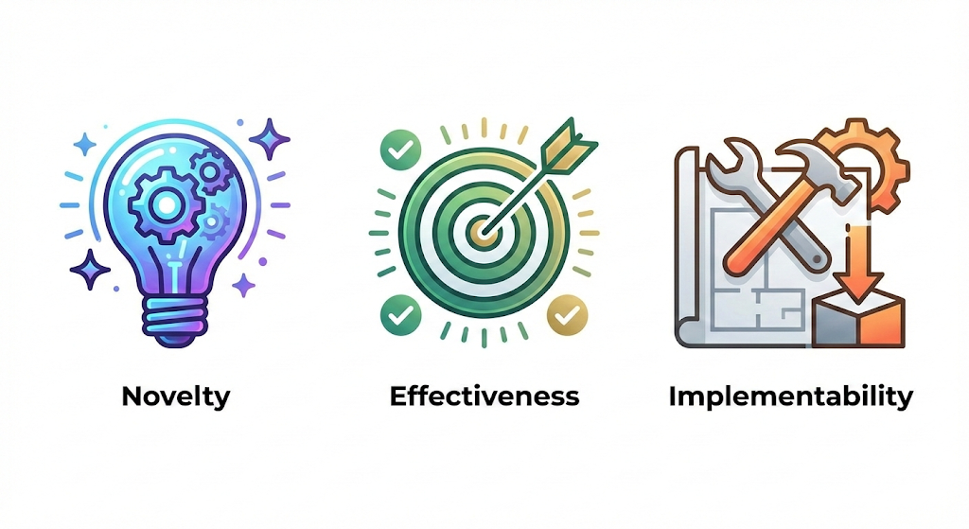
How are skills assessed?
NOVELTY
is the element of originality. For an idea to be novel, it must diverge from the status quo. Novelty can range from "Incremental" to "Radical“
EFFECTIVENESS
is the element of utility. An idea must solve the specific problem it was meant to solve. In educational contexts, this is often called "appropriateness" or "relevance.“
IMPLEMENTABILITY
is the element of feasibility. This is where creativity meets reality. An idea is only truly creative in a professional context if it can be executed with the available.
Example:
The different components of creativity
CREATIVITY

Slide 43
How are skills assessed?
A RUBRIC is a core tool to assess skills and the level of proficiency.
Rubrics are assessment grids used to assess the level of proficiency for a skill and each components
We use a rubric to assess each of the 4Cs. For all of them we use a standard proficiency level set; a 4-level numeric scale:
  Level 1: Novice - 0.25
  Level 2: Limited - 0.50
  Level 3: Good - 0.75
  Level 4: Excellent - 1.00
Each of the 4Cs has a different set of components.
In augMENTOR, to accommodate multiple learning settings and contexts we have produced agnostic rubrics for each of the 4Cs. These rubrics are meant to act as the starting point and main guideline for any activity-specific rubric.

Slide 44
4cs rubric Components - CREATIVITY
Creativity
 | Novelty | Effectiveness | Implementability
0.25 | Repeats given ideas; minimal variation; limited relevance. | Solution does not address the stated goal; weak logic. | Ignores constraints (time/tools/skills); plan not actionable.
0.50 | 1–2 new ideas but derivative or narrow; partial fit to task. | Addresses goal superficially; limited evidence of value. | Partially feasible; key steps, resources, or risks under-specified.
0.75 | Original idea adapted to context; anticipates basic constraints. | Meets core goals; evidence of usefulness for stakeholders. | Feasible plan with steps, roles, and basic risk mitigation.
1.00 | Distinctive, high-impact idea; clear value and transfer beyond the brief. | Optimally solves the problem; compelling evidence of value and improvement. | Detailed, resource-aware plan with contingencies and clear timeline.

Slide 45
4cs rubric Components – Critical thinking
Critical Thinking
 | Identification of components | Exploration | Critical Perspective
0.25 | Restates the problem vaguely; misses key concepts. | Considers a single perspective; no comparison. | Opinion asserted without evidence.
0.50 | Names some components; confuses or omits important ones. | Lists alternative views with minimal analysis. | Cites a source but offers limited reasoning.
0.75 | Accurately decomposes problem; distinguishes facts vs. claims. | Compares perspectives using relevant criteria/evidence. | Defends a position with coherent evidence and logic.
1.00 | Comprehensive model of components/relations; surfaces assumptions. | Integrates multiple perspectives; explains trade-offs and limits. | Synthesizes diverse, credible evidence; anticipates counterarguments.

Slide 46
4cs rubric Components - collaboration
Collaboration
 | Sharing understanding & objectives | Taking appropriate action | Team organisation
0.25 | Team lacks a common goal; misunderstandings persist. | Actions unfocused; no monitoring. | Roles unclear; uneven participation.
0.50 | Partial agreement on goals; limited clarification practices. | Basic plan; sporadic follow-up; deadlines slip. | Roles assigned but poorly coordinated; weak tooling.
0.75 | Clear shared goal; team checks/updates understanding. | Plan–do–check cycles; adapts actions to evidence. | Clear roles; equitable workload; basic shared tools used well.
1.00 | Robust shared mental model; proactive clarification and alignment. | Data-driven adjustments; sustained momentum and quality control. | Dynamic role re-balancing; effective shared tooling; smooth hand-offs.

Slide 47
4cs rubric Components - communication
Communication
 | Adaptability | Media Effectiveness | Context Effectiveness
0.25 | One-size-fits-all message; purpose unclear. | Poor medium choice; visuals/data distract or mislead. | Ignores context/culture/protocols; barriers remain.
0.50 | Some audience awareness; inconsistent tone/clarity. | Medium somewhat suitable; basic visual/data support. | Attempts to adapt; occasional mismatches or jargon.
0.75 | Message tailored to purpose/audience; clear structure. | Appropriate medium; visuals/data reinforce key points. | Adapts register and format to context; attends to accessibility.
1.00 | Precisely calibrated for audience/purpose; persuasive and concise. | Optimal media mix; visuals/data integrated cleanly and accessibly. | Fluent across diverse contexts; inclusive, ethical, and compliant.

Slide 48
What is the purpose of a 4c rubric?
A 4C rubric serves several purposes:
Assess transversal skills systematically
Increase transparency of expectations for learners
Provide AI-ready standardised data so the augMENTOR platform may:
  Monitor development of transversal skills over time
  Generate feedback and recommendations for learners and tutors
  Inform course redesign and policy-level insights
Ensure consistency across courses thanks to the shared 0.25-1.0 scale and components

Slide 49
How to construct a 4c rubric?
Start from the skills and their components
  Identify which C(s) are involved in the course and need to be assessed
  For each C, use its 3 agnostic components as a starting point
Edit the agnostic rubric for each of Cs and their components
  Use the proposed rubrics to create new instances adapted to your course and its subject.
Write rich, diverse descriptions for each component and proficiency level
  Avoid repeating the same sentence with minor changes.
  Make each level’s description specific, clear and distinct.
Apply the standard scoring scale
  Assign the numeric values: 0.25 – 0.50 – 0.75 – 1.00
Integrate the rubrics in the right e-Activities
  Integrate the respective rubrics to the e-Activities depending on what skills each activity is meant to develop.
Rubrics are constructed for the entire course and used in multiple activities across the course.
Rich descriptions= higher quality AI recommend-ations

Slide 50
Formative assessment
monitoring progress and provide ongoing feedback that helps learners improve and educators adjust their instruction
Educators can monitor progress by using the same rubrics at regular time intervals
Checking progress at regular time intervals during the course gives the opportunity to educators to aid the process and make adjustments to it so to maximize course impact
Feedback can be shared with learners to foster
communication, inclusivity and collaboration towards
the common goal: maximizing skills development.
Formative assessment is essential to maximize course impact and address learners’ needs effectively

Slide 51
4cs & 4c rubrics across the tesa phases
Phase A
Phase B
Phase C
Phase D
Phase E
Phase F
Phase G
Phase H
  Decide which 4Cs are naturally connected to your topic
  Use pre-post surveys to explore learners’ current 4C-related attitudes and skills
  Anticipate where learners may struggle cognitively and which skills need more scaffolding
  Explicitly state 4C learning outcomes
  Decide which 4C rubric scores will provide evidence for those outcomes
  Select tools and materials that enable and foster the development of the 4Cs
  Prepare 4C rubrics as part of your “toolkit”
  Design your e-activities so to promote skills development
  Integrate the proper rubrics in each e-activity
  During implementation, observe and facilitate 4C development using the rubrics as a reference.
  Engage in formative assessment episodes using the rubrics, share input with your learners and adjust your course if needed.
  Perform summative assessment and document 4Cs development over time using the rubrics
The 4Cs and rubrics are not only about assessment (Phase G);
They are “present” across all 8 phases.

Slide 52
Contents
Objectives
the augMENTOR solution
The tesa FRAMEWORK
CREATIVE PEDAGOGY AND THE 4Cs
4cs assessment
CREATE AN AUGMENTOR COURSE the augmentor platform

Slide 53
Designing your course with tesa
Use the TESA framework to design your course effectively
Deploy UDL tips to foster inclusion
Consider inquiry-based learning and student-centred approaches
Ensure activities promote the development of the 4Cs
Make rich and diverse rubrics for effective formative assessment

Slide 54
CREATE AN AUGMENTOR COURSE
The augMENTOR workflow
PHASE I: Establish a connection between augMENTOR and your Learning Management System
PHASE II: Build your augMENTOR course
PHASE III: Have your course imported in augMENTOR
PHASE IV: Use augMENTOR while running your course

Slide 55
PHASE I: augMENTOR – LMS connection
To get started you will need to establish a contact between your Learning Management System (LMS) and augMENTOR
Contact the augMENTOR team to receive instructions
Ask your IT administrator to provide the necessary
information to the augMENTOR team
The augMENTOR team will do
the technical setup and verify
a stable a secure connection
Once the connection is established course data will be retrieved periodically without further actions from the educator.

Slide 56
PHASE II: Build your augMENTOR course
Once the connection with augMENTOR is set it time to build your augMENTOR course in your LMS.
Follow the TESA framework to prepare your educational course
Create the rubrics of your course based on the creative pedagogy strategy
Parse your course in the LMS, following the instructions that follow.
augMENTOR is currently mapped with Moodle. Follow these guidelines to setup an augMENTOR course in Moodle.
For other LMSs you will need further assistance from the augMENTOR team.

Slide 57
PHASE II: Build your augMENTOR course
1. Activities selection
Courses should only include the following activity/resource types (linked to TESA Phase D):
  Resources (links, texts, videos)
  Assignments
  Forum
  Quiz
  SCORM
  Feedback (only for pre-post questionnaire and mental effort questions as indicated below)
Educators can reuse these in any combination and as many times as they find useful

Slide 58
PHASE II: Build your augMENTOR course
2. Setup: Pre-Post assessment and mental effort
For the AI to establish an initial learner profile and monitor cognitive factors over time, two specific elements must be included in the course design:
Pre-post questionnaires
  The course must start and end with the same questionnaire.
  Linked to TESA Phase B (Cognitive Analysis).
  Used to assess learners’ current level (cognitive + 4Cs).
  Questions may change slightly in wording, but answer options must remain identical.
  Answers must be ordinal (e.g. Very Low – Low – Average – High – Very High)
Use content type ‘Feedback’ for the pre-post questionnaires and ensure that under ‘Question and submission settings’ section the ‘Record user names’ section is not set to ‘Anonymous’.

Slide 59
PHASE II: Build your augMENTOR course
2. Setup: Pre-Post assessment and mental effort
Effort level | Value | Text
Extremely Low | 1 | Extremely low intellectual effort
Very Low | 2 | Very low intellectual effort
Low | 3 | Low intellectual effort
Relatively Low | 4 | Relatively low intellectual effort
Neutral | 5 | Neither low nor high intellectual effort
Relatively High | 6 | Relatively high intellectual effort
High | 7 | High intellectual effort
Very High | 8 | Very high intellectual effort
Extremely High | 9 | Extremely high intellectual effort
Mental effort question:
At the end of each module, a single question that measures the perceived mental effort expended to complete the thematic section needs to be included, using the following scale:
Use content type ‘Feedback’ for the mental effort questions and ensure that under ‘Question and submission settings’ section the ‘Record user names’ section is not set to ‘Anonymous’.

Slide 60
PHASE II: Build your augMENTOR course
3. Implementing the 4Cs assessment (Creative Pedagogy)
  Enable Rubrics in the ‘Advance Grading’ section for the necessary activities
  Use the 4-level numeric scale indicated for the proficiency levels in the rubrics
  Mandatory tagging: Add the name of the corresponding skill written in English and enclosed in parenthesis in the title before the name of every skill/component
  (eg. (critical thinking) Discerning between fact and opinions.
4. Roles assignment
Role information is foundational data for the platform and should be properly set:
Educators = Teacher role | Learner = Student role
Mandatory tagging is very important for the AI model to correctly map the data.

Slide 61
Integrating a moodle course in the augmentor platform
Before integration make sure all needed elements are in place…
Design first: Build your Moodle course using the TESA structure so collected data aligns with the Learner Model and augMENTOR’s knowledge graph.
Use the supported activity set only: Resources, Assignments (ASSIGN), Forum, Quiz, SCORM. (You can use any combination, as many times as needed.)
Design 4Cs assessment via rubrics: Enable advanced grading in ≥1 activity per module; use the 4-level scale 0.25/0.5/0.75/1.0 with rich, non-repetitive descriptors; add mandatory tagging.
Prepare pre-post questionnaires & Mental effort: Same items at start & end with ordinal answers; add a 1–9 mental-effort item at the end of each module.

Slide 62
Integrating a moodle course in the augmentor platform
Once your course is complete the technical team will load it in augMENTOR.
After you start using your course and your learners start to interact with it in the LMS, data will be generated and parsed to augMENTOR.
You will then be able to start using augMENTOR and perform queries about your learners.
Feedback and recommendations will be generated based on the data coming from the implementation of your course.
Data will be retrieved periodically without further actions from the educator.

Slide 63
Contents
Objectives
the augMENTOR solution
The tesa FRAMEWORK
CREATIVE PEDAGOGY AND THE 4Cs
4cs assessment
CREATE AN AUGMENTOR COURSE the augmentor platform

Slide 64
What does the augMENTOR platform offer?
It acts as an intelligent pedagogical partner
  It turns raw course data into actionable insights
  It does not offer just simple data display
  It provides concrete pedagogical analysis.
  It supports educators in monitoring individual students’ progress
What the platform is
An evidence-based, course-linked AI that transforms your course data into feedback, guidelines and recommendations.
Human-vetted i.e. educators can review/edit recommendations before sending to learners and can inspect/adjust profiles.
What the platform is NOT
A general-purpose chatbot (e.g. ChatGPT/Gemini) and not a web search tool: it won’t invent or synthesise answers beyond your designated course data.
A replacement for teachers: augMENTOR positions AI as a supportive mechanism within a pedagogical framework; final judgment stays with the educator.

Slide 65
What does the augMENTOR platform offer?
Educators can
Learners can
Make structured queries
Make structured queries
Receive feedback
Receive feedback
Receive guidelines and editable recommendations
Request recommendations approved/edited by the educator
Explore profiles

Slide 66
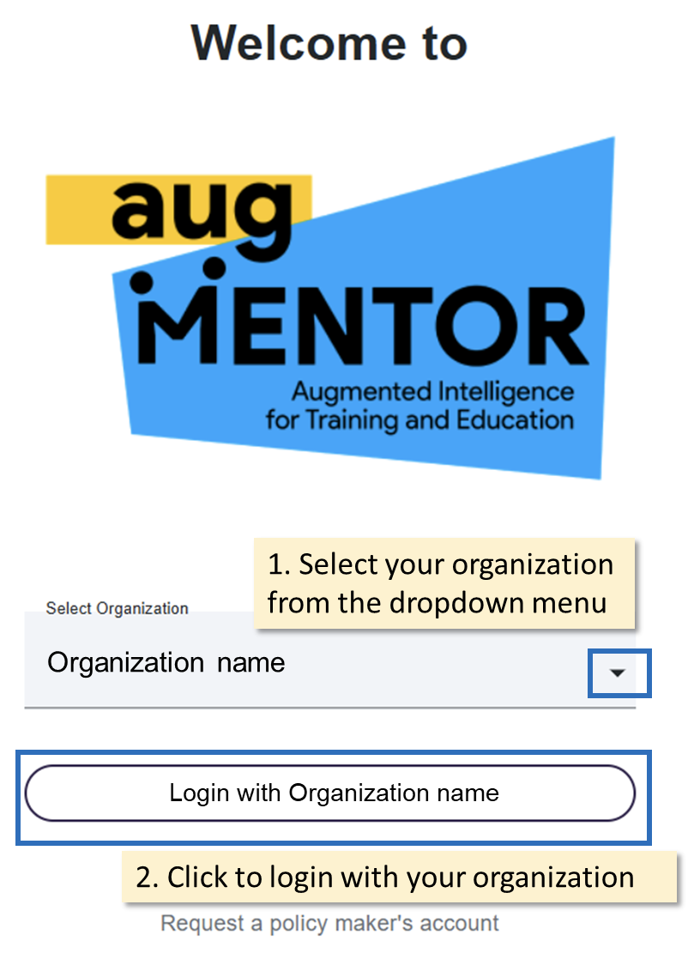
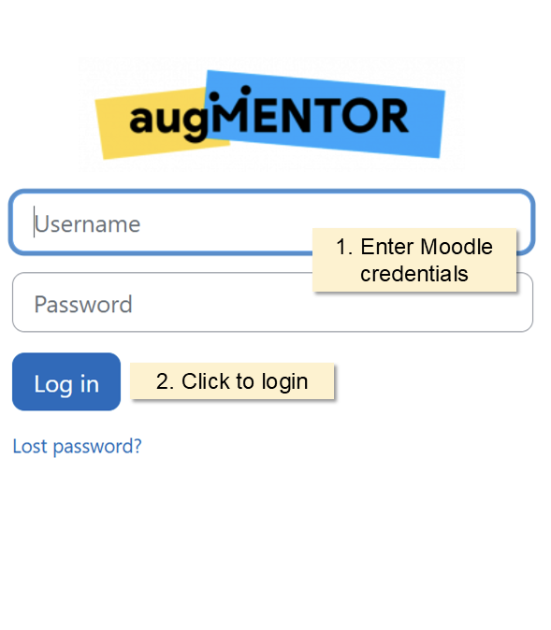
The augmentor platform
You can visit the augMENTOR platform through this link:
https://augmentor-app.eu-dev.novelcore.org/login
If you don’t have an account yet, you can test augMENTOR using our demo course!
Organization: Demo course
User name: demo_educator
Password: #Abcd123

Slide 67
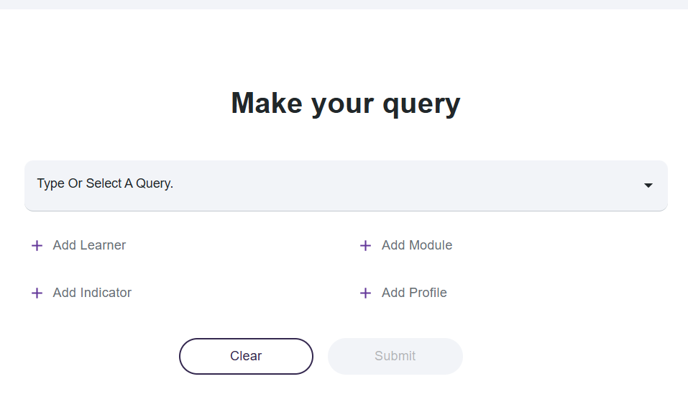
Making queries
Once you enter augMENTOR, you are ready start using it by making queries

Slide 68
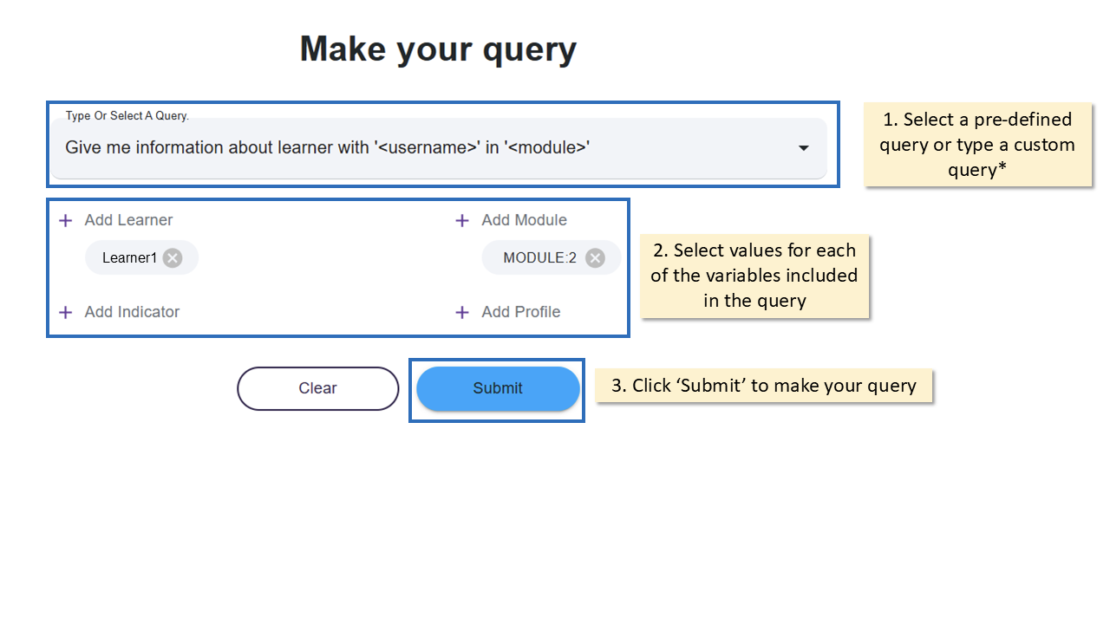
Making queries
Once you enter augMENTOR, you are ready start using it by making queries

Slide 69
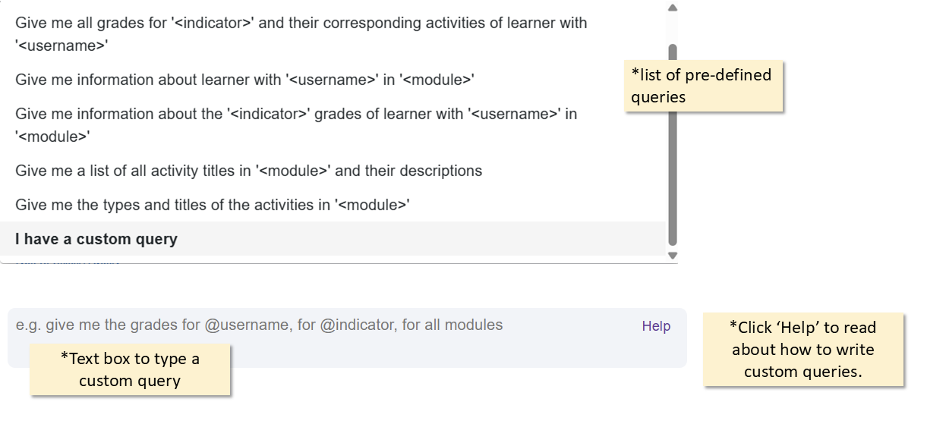
Making queries
Start by selecting a query from the predefined list or type your own
Click the help button to learn how to properly construct custom queries.
augMENTOR is not designed as a chatbot. It is designed to provide structured feedback and recommendations based on the specifics of a course and TESA framework.
It is best used to monitor learners and personalize the learning process for them.

Slide 70
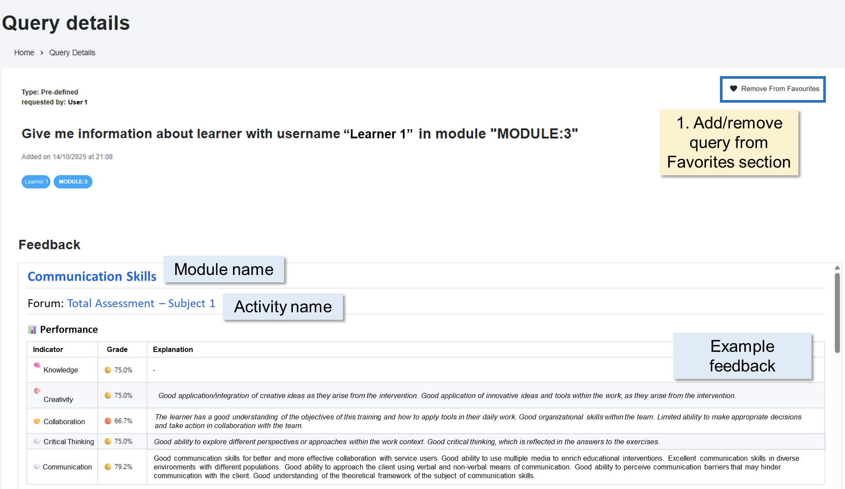
QUERY DETAILS PAGE
Once a query is submitted, the user is directed to the query details page which has four (4)sections:
Feedback,
Guidelines for course design
Recommendations
Notes
Feedback can vary depending on
the query; it includes information
and analytics based on the
course data.

Slide 71
Making queries
The variables that can be included in a query are:
● Learner -A list of all learners included in the course.
● Indicator - The learning aspects studied based on the pedagogical framework; namely: Knowledge, Creativity, Critical Thinking, Collaboration, Communication.
● Module - The list of module titles as
retrieved from Moodle.
● Profile - The list of augMENTOR profiles
as generated by the system.

Slide 72

Visit the
augMENTOR user Guide
for a detailed tour of the platform!

Slide 73
Making correct queries
Principles for correct queries
Hint for Educators:
The platform only answers from the designated course’s data and no generic advice.
Use the built-in variables in your phrasing: Learner, Indicator, Module, Profile.
Keep it short: Avoid narratives. If nothing returns, it’s usually missing evidence or wording - rephrase with variables.

Slide 74
Making correct queries
Query patterns
When asking for information, it is important to define the values in each of the query’s variables.
Example 1: Give me the “indicator” grades of learner with username “learner’s username” in “module 1”
  Indicator: Could be “Knowledge”, “Creativity”, “Collaboration”, “Critical Thinking”, “Communication”
  Username: It defines the learner(s) for which someone can request information. Users are able to request data for multiple learners, not just one.
  Module: The name of the module that users request data.
Learners can only make queries about themselves.
Educators can make queries about all learners in the course.

Slide 75
Making correct queries
Query patterns
When asking for information, it is significant to define the values in each of the query’s variables.
  Example #2: Give me all grades for indicator ‘Creativity’ and their corresponding activities for learner with username ‘user1’
  Example #3: Give me a list of all activity titles in “Module 2” and their descriptions
  Example #4: Give me the types and titles of the activities in “Module 3”
  Example #5: Give me information for learner with username “Learner 12” for indicator “Collaboration” in module “Module 4”
  Give me recommendation for learner with username “Learner 1” for indicator “Collaboration” in module “MODULE:1”

Slide 76

Enjoy using augmentor!
The augMENTOR project (GA No. 101061509) is funded by the European Union. Views and opinions expressed are however those of the author(s) only and do not necessarily reflect those of the European Union. The European Union cannot be held responsible for them.

